Slide 1
Differential Calculus and Coordinate Geometry Final term
Coordinate Geometry of Two Dimensions
Circle
Conic Sections
Three-dimensional Coordinate Geometry
Vectors
Equations of Lines and Planes
Function of several Variables
Partial Derivatives
Maximum and Minimum Values
Reference book : Calculus-James Stewart-Eighth Edition

Slide 2

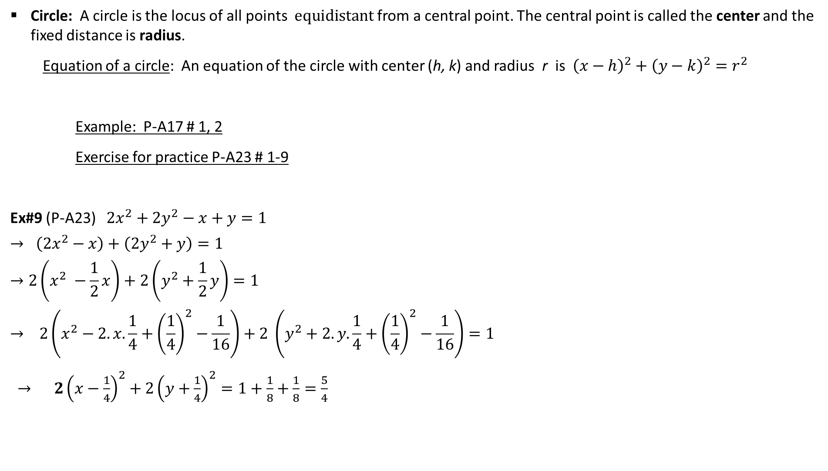
Circle: A circle is the locus of all points $equidistant$ from a central point. The central point is called the center and the fixed distance is radius.
Equation of a circle: An equation of the circle with center (h, k) and radius r is ${\left(x−h\right)}^{2}+{\left(y−k\right)}^{2}=r^{2}$
Example: P-A17 # 1, 2
Exercise for practice P-A23 # 1-9
Ex#9 (P-A23) $2x^{2}+2y^{2}−x+y=1$
$$→ \left(2x^{2}−x\right)+\left(2y^{2}+y\right)=1$$
$$→2\left(x^{2} −\frac{1}{2}x\right)+2\left(y^{2}+\frac{1}{2}y\right)=1$$
$$→ 2\left(x^{2}−2.x.\frac{1}{4}+{\left(\frac{1}{4}\right)}^{2}−\frac{1}{16}\right)+2 \left(y^{2}+2.y.\frac{1}{4}+{\left(\frac{1}{4}\right)}^{2}−\frac{1}{16}\right)=1$$
$→ 2{\left(x−\frac{1}{4}\right)}^{2}+2{\left(y+\frac{1}{4}\right)}^{2}=1+\frac{1}{8}+\frac{1}{8}=\frac{5}{4}$
r
(h,k)
$${\left(x−\frac{1}{4}\right)}^{2}+{\left(y+\frac{1}{4}\right)}^{2}=\frac{5}{8}={\left(\frac{\sqrt{5}}{2\sqrt{2}}\right)}^{2}$$
This represents a circle with center $\left(\frac{1}{4}, −\frac{1}{4}\right) and radius\frac{\sqrt{5}}{2\sqrt{2}}$ .

Slide 3
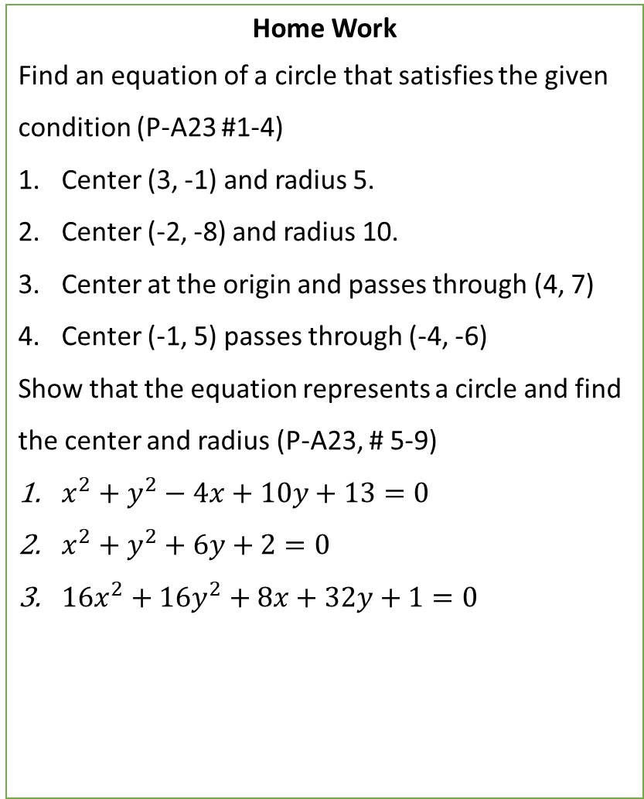
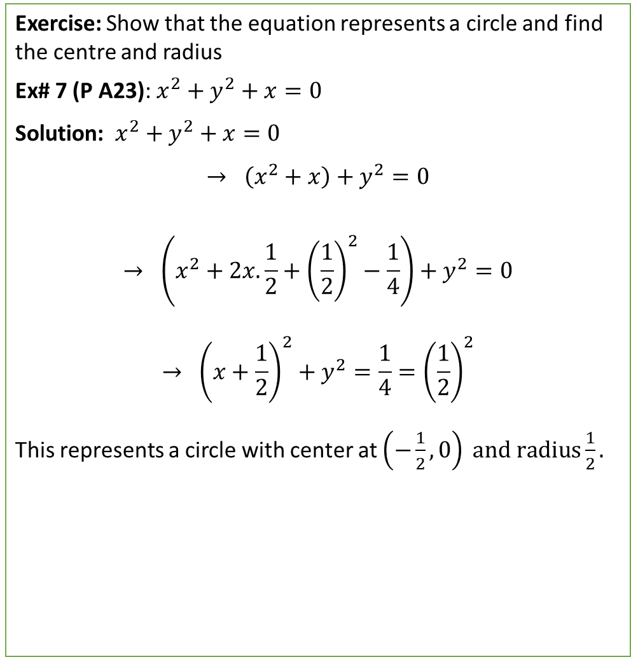
Exercise: Show that the equation represents a circle and find the centre and radius
Ex# 7 (P A23): $x^{2}+y^{2}+x=0$
Solution: $x^{2}+y^{2}+x=0$
$$→ \left(x^{2}+x\right)+y^{2}=0$$
$$→ \left(x^{2}+2x.\frac{1}{2}+{\left(\frac{1}{2}\right)}^{2}−\frac{1}{4}\right)+y^{2}=0$$
$$→ {\left(x+\frac{1}{2}\right)}^{2}+y^{2}=\frac{1}{4}={\left(\frac{1}{2}\right)}^{2}$$
This represents a circle with center at $\left(−\frac{1}{2}, 0\right) \text{and} \text{radius}\frac{1}{2}.$
Home Work
Find an equation of a circle that satisfies the given condition (P-A23 #1-4)
Center (3, -1) and radius 5.
Center (-2, -8) and radius 10.
Center at the origin and passes through (4, 7)
Center (-1, 5) passes through (-4, -6)
Show that the equation represents a circle and find the center and radius (P-A23, # 5-9)
$x^{2}+y^{2}−4x+10y+13=0$
$x^{2}+y^{2}+6y+2=0$
$16x^{2}+16y^{2}+8x+32y+1=0$
(-1/2 ,0)

Slide 4

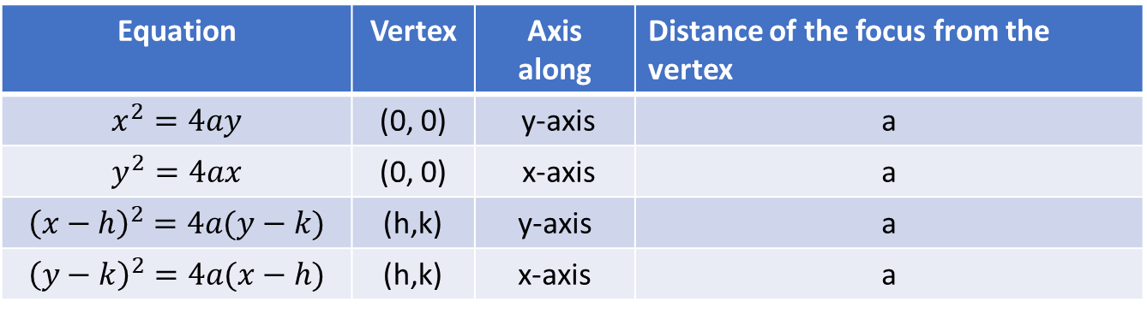



Conic Sections
Parabola A parabola is the set of points in a plane that are equidistant from a fixed point F (called the focus) and a fixed line (called the directrix).
The line through the focus perpendicular to the directrix is called the axis of the parabola.
The point halfway between the focus and the directrix lies on the parabola is called the vertex.
Equation of a parabola:
Equation | Vertex | Axis along | Distance of the focus from the vertex
$$x^{2}=4ay$$ | (0, 0) | y-axis | a
$$y^{2}=4ax$$ | (0, 0) | x-axis | a
$${\left(x−h\right)}^{2}=4a(y−k)$$ | (h,k) | y-axis | a
$${\left(y−k\right)}^{2}=4a(x−h)$$ | (h,k) | x-axis | a
y
(0, a)
x
(0,-a)
(a,0)
(-a, 0)
$$y^{2}=4ax$$
$$y^{2}=−4ax$$
$$x^{2}=4ay$$
$$x^{2}=−4ay$$

Slide 5
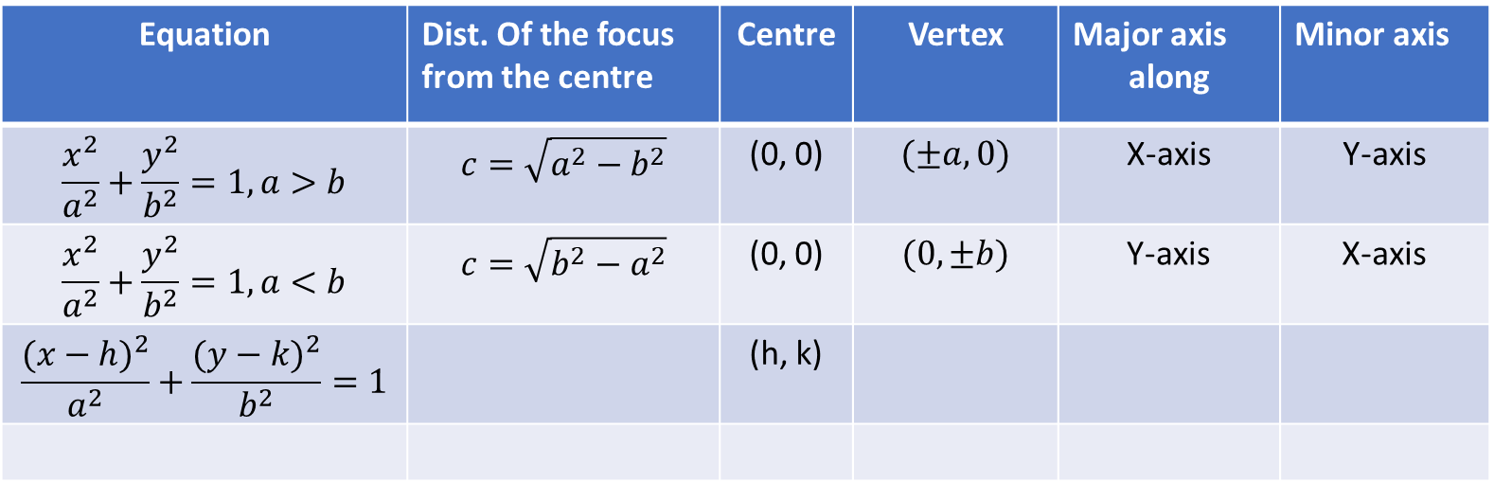
Ellipse
Definition: An ellipse is the set of all points in a plane the sum of whose distances from two fixed points, called foci, is a constant.
Equation | Dist. Of the focus from the centre | Centre | Vertex | Major axis along | Minor axis
$$\frac{x^{2}}{a^{2}}+\frac{y^{2}}{b^{2}}=1,a>b$$ | $$c=\sqrt{a^{2}−b^{2}}$$ | (0, 0) | $$(±a, 0)$$ | X-axis | Y-axis
$$\frac{x^{2}}{a^{2}}+\frac{y^{2}}{b^{2}}=1,a<b$$ | $$c=\sqrt{b^{2}−a^{2}}$$ | (0, 0) | $$(0, ±b)$$ | Y-axis | X-axis
$$\frac{{(x−h)}^{2}}{a^{2}}+\frac{{(y−k)}^{2}}{b^{2}}=1$$ |  | (h, k)
y
y
y
x
x
x
a>b
a<b
(h, k)

Slide 6
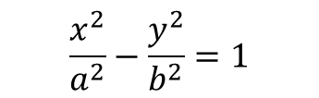
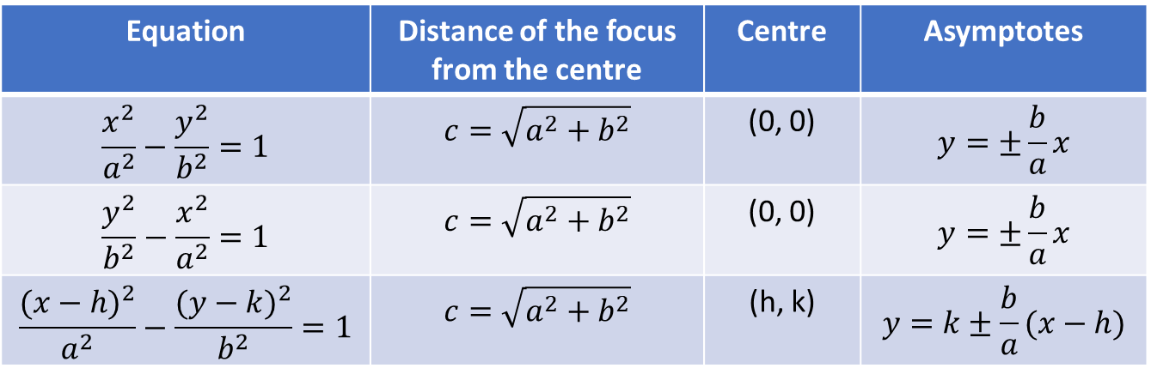
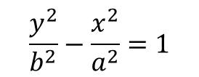
Hyperbola : A hyperbola is the set of all points in a plane the difference of whose distances from two fixed points, called foci, is a constant.
Exercise for practice P-A23 # 11-22, 24-32 Identify, sketch and locate foci and vertices.
Equation | Distance of the focus from the centre | Centre | Asymptotes
$$\frac{x^{2}}{a^{2}}−\frac{y^{2}}{b^{2}}=1$$ | $$c=\sqrt{a^{2}+b^{2}}$$ | (0, 0) | $$y=±\frac{b}{a}x$$
$$\frac{y^{2}}{b^{2}}−\frac{x^{2}}{a^{2}}=1$$ | $$c=\sqrt{a^{2}+b^{2}}$$ | (0, 0) | $$y=±\frac{b}{a}x$$
$$\frac{{(x−h)}^{2}}{a^{2}}−\frac{{(y−k)}^{2}}{b^{2}}=1$$ | $$c=\sqrt{a^{2}+b^{2}}$$ | (h, k) | $$y=k±\frac{b}{a}(x−h)$$
$$\frac{y^{2}}{b^{2}}−\frac{x^{2}}{a^{2}}=1$$
$$\frac{x^{2}}{a^{2}}−\frac{y^{2}}{b^{2}}=1$$

Slide 7
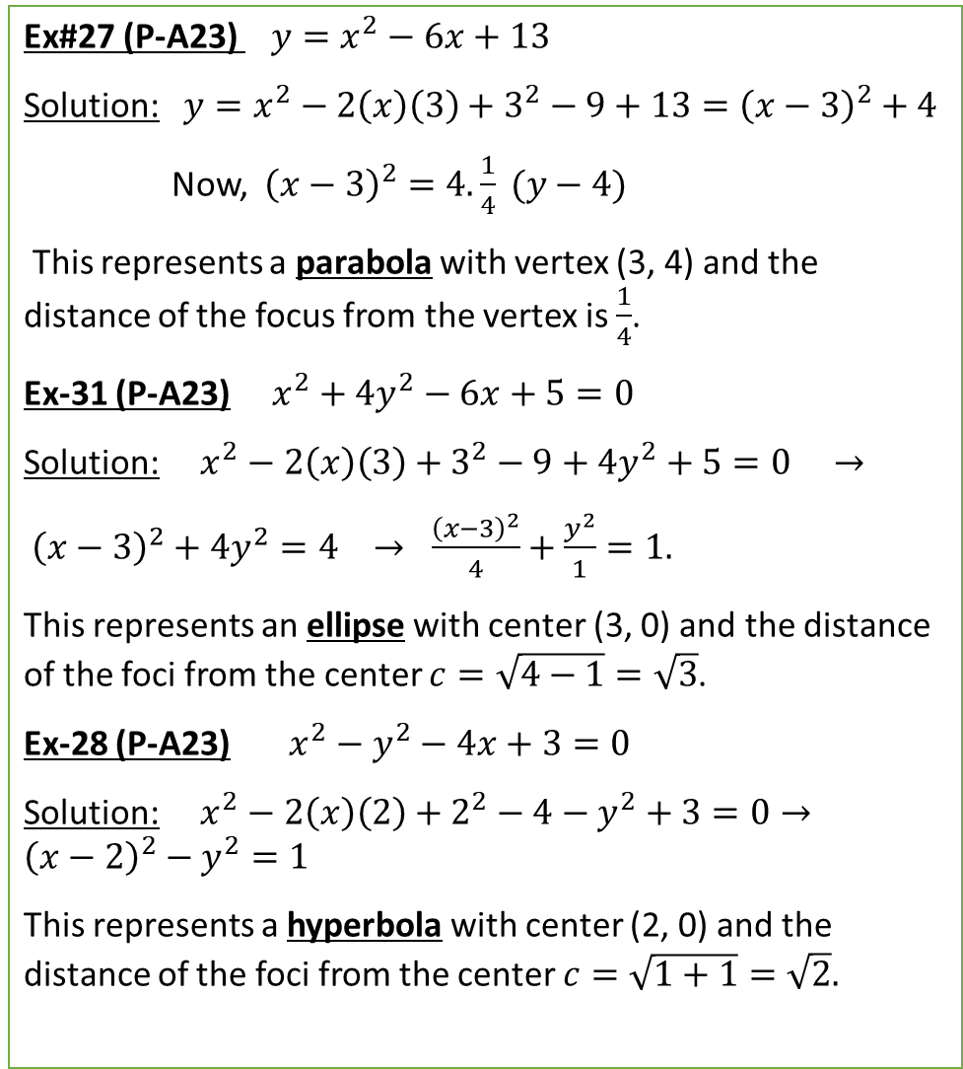
Ex#27 (P-A23) $y=x^{2}−6x+13$
Solution: $y=x^{2}−2\left(x\right)\left(3\right)+3^{2}−9+13={\left(x−3\right)}^{2}+4$
Now, ${\left(x−3\right)}^{2}=4.\frac{1}{4} (y−4)$
This represents a parabola with vertex (3, 4) and the distance of the focus from the vertex is $\frac{1}{4}$.
Ex-31 (P-A23) $x^{2}+4y^{2}−6x+5=0$
Solution: $x^{2}−2\left(x\right)\left(3\right)+3^{2}−9+4y^{2}+5=0 →$
${\left(x−3\right)}^{2}+4y^{2}=4 → \frac{{\left(x−3\right)}^{2}}{4}+\frac{y^{2}}{1}=1.$
This represents an ellipse with center (3, 0) and the distance of the foci from the center $c=\sqrt{4−1}=\sqrt{3}$.
Ex-28 (P-A23) $x^{2}−y^{2}−4x+3=0$
Solution: $x^{2}−2\left(x\right)\left(2\right)+2^{2}−4−y^{2}+3=0→{\left(x−2\right)}^{2}−y^{2}=1$
This represents a hyperbola with center (2, 0) and the distance of the foci from the center $c=\sqrt{1+1}=\sqrt{2}.$
(3, 4)
(3, 0)
(2,0)

Slide 8
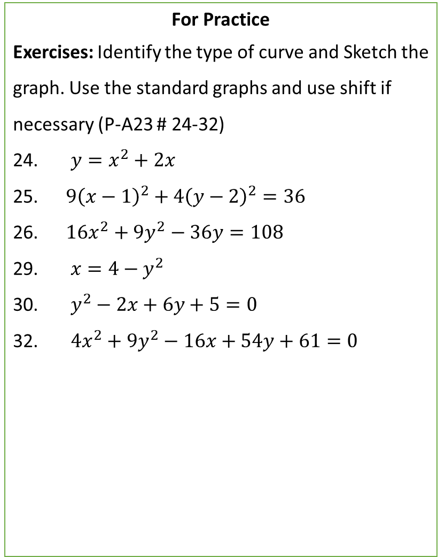
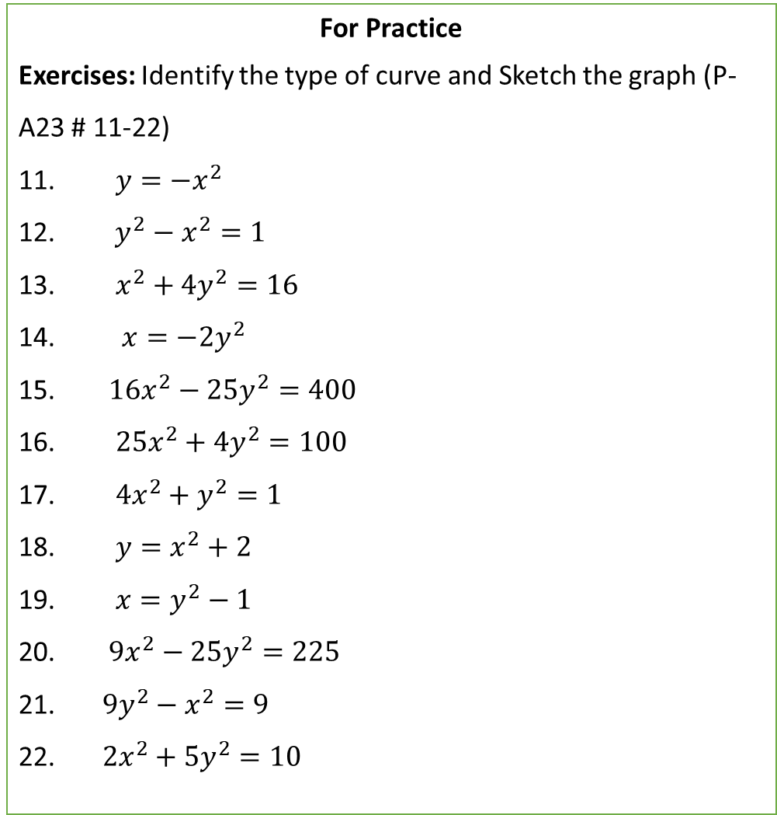
For Practice
Exercises: Identify the type of curve and Sketch the graph (P-A23 # 11-22)
11. $y=−x^{2}$
12. $y^{2}−x^{2}=1$
13. $x^{2}+4y^{2}=16$
14. $x=−2y^{2}$
15. $16x^{2}−25y^{2}=400$
16. $25x^{2}+4y^{2}=100$
17. $4x^{2}+y^{2}=1$
18. $y=x^{2}+2$
19. $x=y^{2}−1$
20. $9x^{2}−25y^{2}=225$
21. $9y^{2}−x^{2}=9$
22. $2x^{2}+5y^{2}=10$
For Practice
Exercises: Identify the type of curve and Sketch the graph. Use the standard graphs and use shift if necessary (P-A23 # 24-32)
$y=x^{2}+2x$
$9{\left(x−1\right)}^{2}+4{\left(y−2\right)}^{2}=36$
$16x^{2}+9y^{2}−36y=108$
29. $x=4−y^{2}$
30. $y^{2}−2x+6y+5=0$
32. $4x^{2}+9y^{2}−16x+54y+61=0$

Slide 9
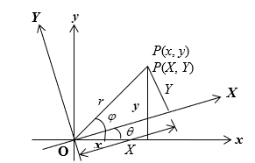
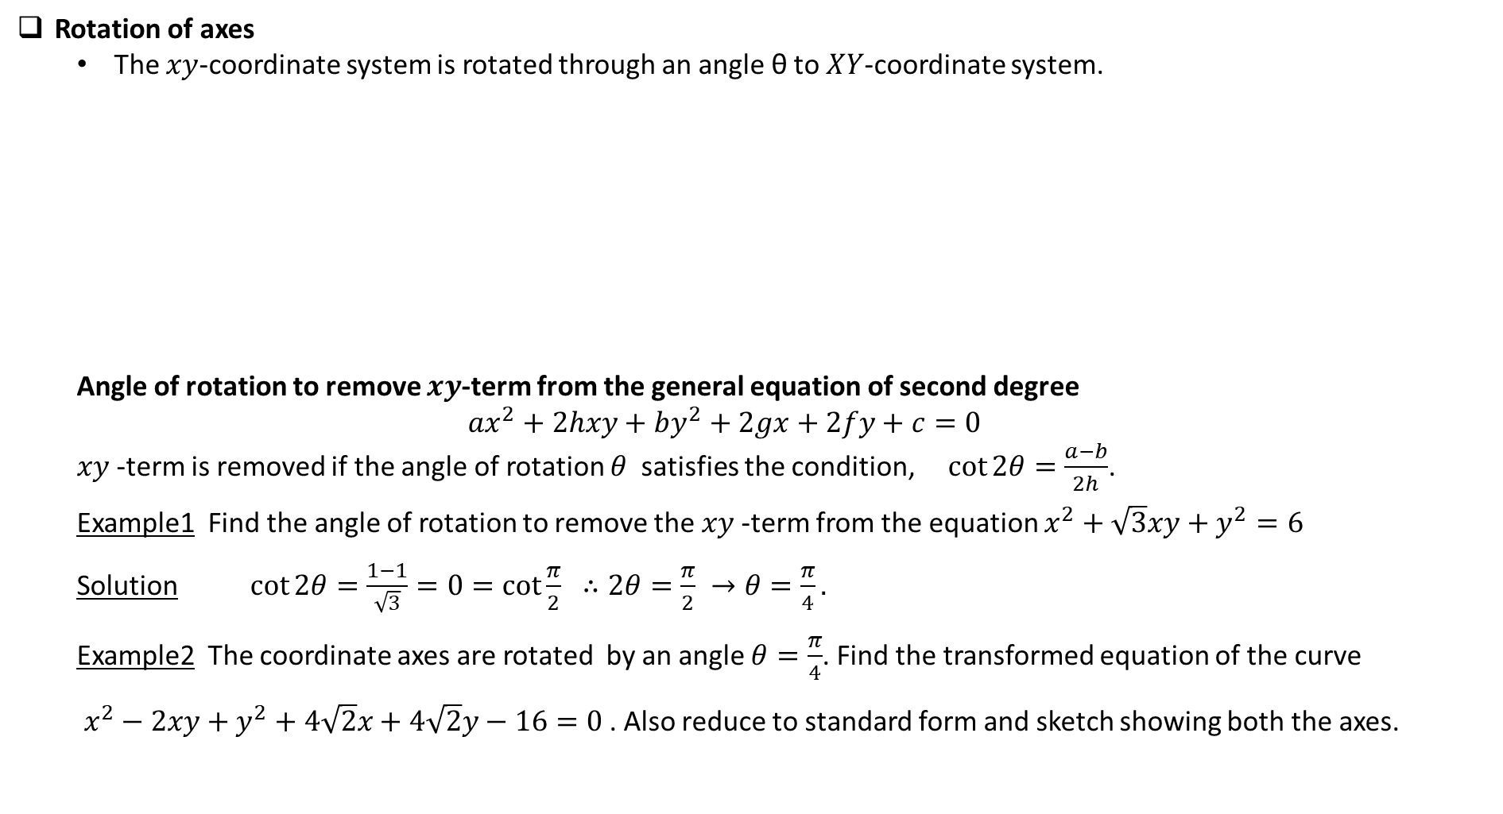
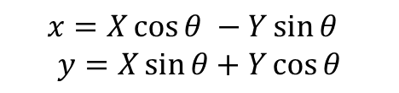
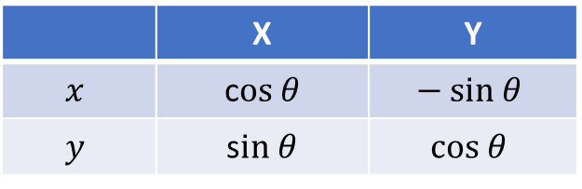
Rotation of axes
The $xy$-coordinate system is rotated through an angle θ to $XY$-coordinate system.
Angle of rotation to remove $xy$-term from the general equation of second degree
$$ax^{2}+2hxy+by^{2}+2gx+2fy+c=0$$
$xy$-term is removed if the angle of rotation $θ$ satisfies the condition, $\cot{2θ}=\frac{a−b}{2h}$.
Example1 Find the angle of rotation to remove the $xy$-term from the equation $x^{2}+\sqrt{3}xy+y^{2}=6$
Solution $\cot{2θ}=\frac{1−1}{\sqrt{3}}=0=\cot{\frac{π}{2}} ∴2θ=\frac{π}{2} →θ=\frac{π}{4}.$
Example2 The coordinate axes are rotated by an angle $θ=\frac{π}{4}$. Find the transformed equation of the curve
$x^{2}−2xy+y^{2}+4\sqrt{2}x+4\sqrt{2}y−16=0$ . Also reduce to standard form and sketch showing both the axes.
Table of transformation
 | X | Y
$$x$$ | c$os θ$ | $$− sin θ$$
$$y$$ | s$in θ$ | $$cos θ$$
$$x=X\cos{θ −Y\sin{θ} }$$
$$y=X\sin{θ+Y\cos{θ}}$$

Slide 10

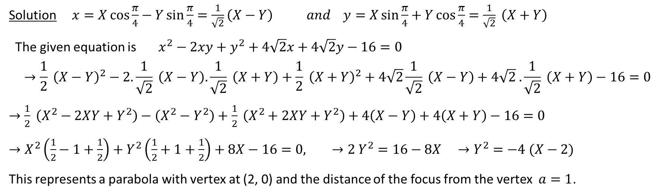


Solution $x=X\cos{\frac{π}{4}−Y\sin{\frac{π}{4}=\frac{1}{\sqrt{2}}\left(X−Y\right)} and y=X\sin{\frac{π}{4}+Y\cos{\frac{π}{4}}=\frac{1}{\sqrt{2}} \left(X+Y\right)} }$
The given equation is $x^{2}−2xy+y^{2}+4\sqrt{2}x+4\sqrt{2}y−16=0$
$$→\frac{1}{2} {\left(X−Y\right)}^{2}−2.\frac{1}{\sqrt{2}} \left(X−Y\right).\frac{1}{\sqrt{2}} \left(X+Y\right)+\frac{1}{2} {\left(X+Y\right)}^{2}+4\sqrt{2}\frac{1}{\sqrt{2}} \left(X−Y\right)+4\sqrt{2} .\frac{1}{\sqrt{2}} \left(X+Y\right)−16=0$$
$→$ $\frac{1}{2} \left(X^{2}−2XY+Y^{2}\right)−\left(X^{2}−Y^{2}\right)+\frac{1}{2} \left(X^{2}+2XY+Y^{2}\right)+4\left(X−Y\right)+4\left(X+Y\right)−16=0$
$→X^{2}\left(\frac{1}{2}−1+\frac{1}{2}\right)+Y^{2}\left(\frac{1}{2}+1+\frac{1}{2}\right)+8X−16=0, →2 Y^{2}=16−8X →Y^{2}=−4 (X−2)$
This represents a parabola with vertex at (2, 0) and the distance of the focus from the vertex $a=1$.
$$y$$
Y
X
 | X | Y
$$x$$ | c$os θ$ | $$− sin θ$$
$$y$$ | s$in θ$ | $$cos θ$$
$$x$$

Slide 11
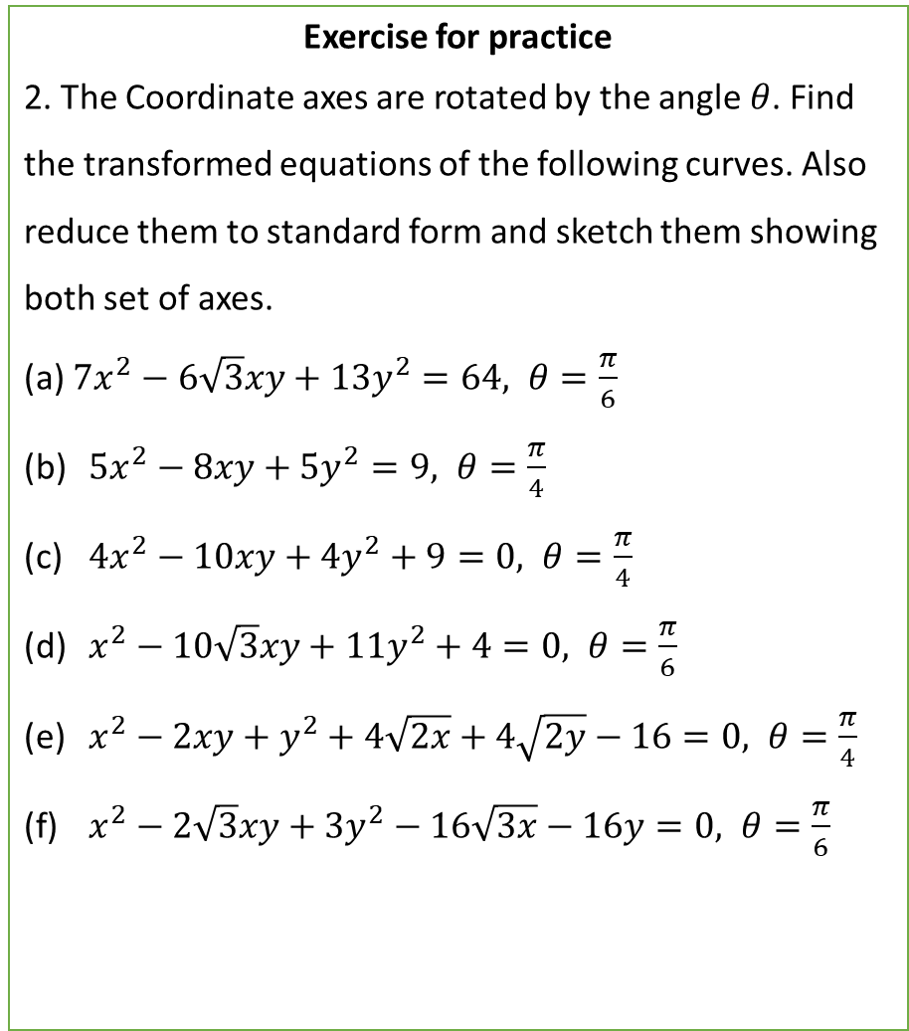
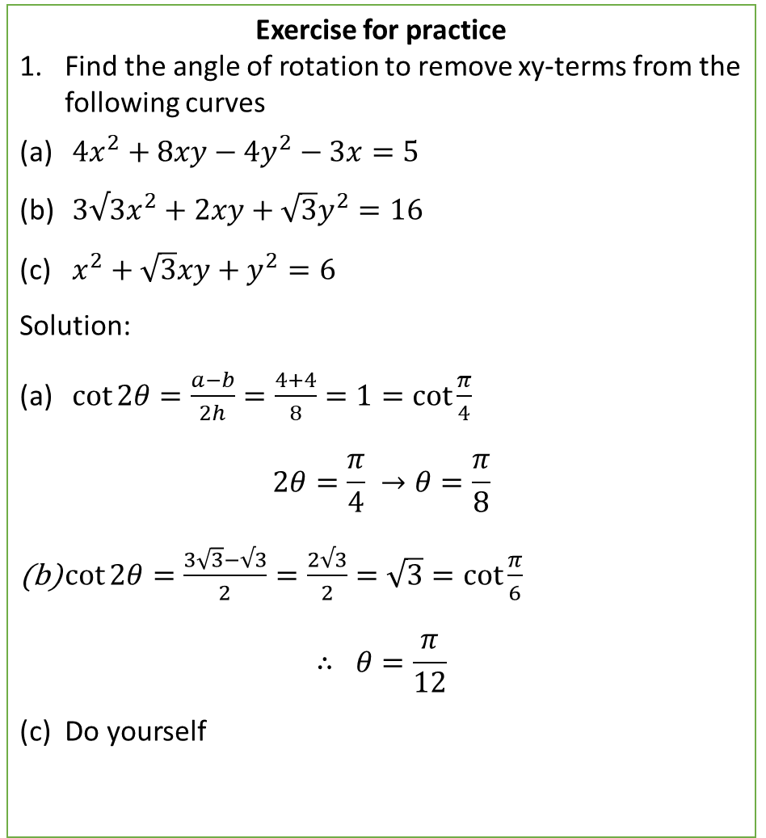
Exercise for practice
Find the angle of rotation to remove xy-terms from the following curves
$4x^{2}+8xy−4y^{2}−3x=5$
$3√3x^{2}+2xy+\sqrt{3}y^{2}=16$
$x^{2}+\sqrt{3}xy+y^{2}=6$
Solution:
$\cot{2θ}=\frac{a−b}{2h}=\frac{4+4}{8}=1=\cot{\frac{π}{4}}$
$$2θ=\frac{π}{4} →θ=\frac{π}{8}$$
$\cot{2θ}=\frac{3\sqrt{3}−√3}{2}=\frac{2√3}{2}=\sqrt{3}=\cot{\frac{π}{6}}$
$$∴ θ=\frac{π}{12}$$
(c) Do yourself
Exercise for practice
2. The Coordinate axes are rotated by the angle $θ$. Find the transformed equations of the following curves. Also reduce them to standard form and sketch them showing both set of axes.
(a) $7x^{2}−6\sqrt{3}xy+13y^{2}=64, θ=\frac{π}{6}$
$5x^{2}−8xy+5y^{2}=9, θ=\frac{π}{4}$
$4x^{2}−10xy+4y^{2}+9=0, θ=\frac{π}{4}$
$x^{2}−10\sqrt{3}xy+11y^{2}+4=0, θ=\frac{π}{6}$
$x^{2}−2xy+y^{2}+4\sqrt{2x}+4\sqrt{2y}−16=0, θ=\frac{π}{4}$
$x^{2}−2\sqrt{3}xy+3y^{2}−16\sqrt{3x}−16y=0, θ=\frac{π}{6}$

Slide 12
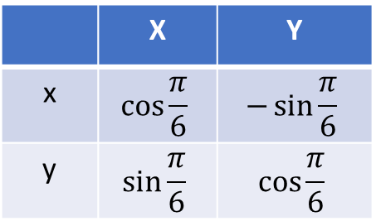
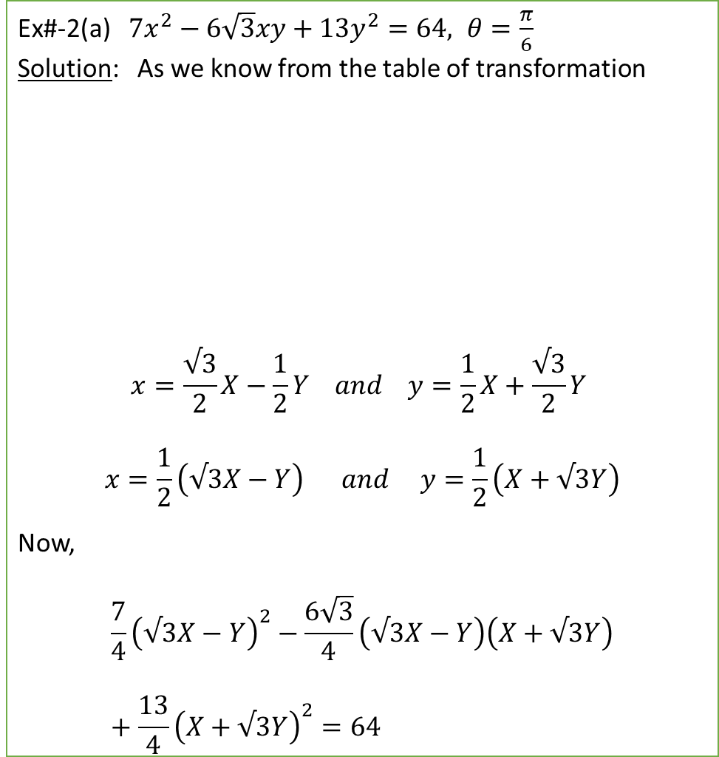

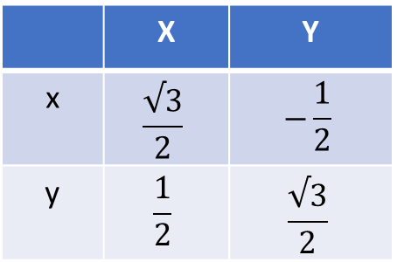
Ex#-2(a) $7x^{2}−6\sqrt{3}xy+13y^{2}=64, θ=\frac{π}{6}$
Solution: As we know from the table of transformation
$$x=\frac{√3}{2}X−\frac{1}{2}Y and y=\frac{1}{2}X+\frac{√3}{2}Y$$
$$x=\frac{1}{2}\left(√3X−Y\right) and y=\frac{1}{2}\left(X+√3Y\right)$$
Now,
$$\frac{7}{4}{\left(√3X−Y\right)}^{2}−\frac{6\sqrt{3}}{4}\left(√3X−Y\right)\left(X+√3Y\right)+\frac{13}{4}{\left(X+√3Y\right)}^{2}=64$$
$$X^{2}\left(21−18+13\right)+Y^{2}\left(7+18+39\right)=256$$
$$16X^{2}+64Y^{2}=256$$
$$\frac{X^{2}}{16}+\frac{Y^{2}}{4}=1$$
$$\frac{X^{2}}{4^{2}}+\frac{Y^{2}}{2^{2}}=1$$
This represents an ellipse.
 | X | Y
x | $$\cos{\frac{π}{6}}$$ | $$−\sin{\frac{π}{6}}$$
y | $$\sin{\frac{π}{6}}$$ | $$\cos{\frac{π}{6}}$$
 | X | Y
x | $$\frac{√3}{2}$$ | $$−\frac{1}{2}$$
y | $$\frac{1}{2}$$ | $$\frac{√3}{2}$$

Slide 13


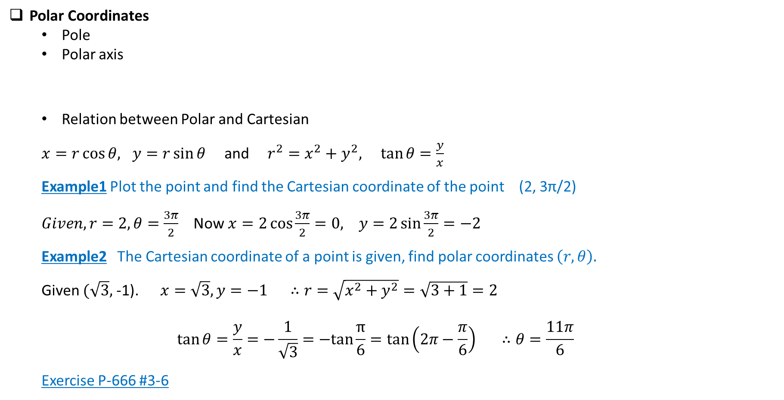



Polar Coordinates
Pole
Polar axis
Relation between Polar and Cartesian
$x=r\cos{θ, y=r\sin{θ}}$ and $r^{2}=x^{2}+y^{2}, \tan{θ=\frac{y}{x}}$
Example1 Plot the point and find the Cartesian coordinate of the point (2, 3π/2)
$Given, r=2, θ=\frac{3π}{2}$ Now $x=2\cos{\frac{3π}{2}}=0, y=2\sin{\frac{3π}{2}}=−2$
Example2 The Cartesian coordinate of a point is given, find polar coordinates $\left(r, θ\right).$
Given $(\sqrt{3},$ -1). $x=\sqrt{3}, y=−1 ∴r=\sqrt{x^{2}+y^{2}}=\sqrt{3+1}=2$
$$\tan{θ}=\frac{y}{x}=−\frac{1}{\sqrt{3}}=−tan\frac{π}{6}=\tan\left(2π−\frac{π}{6}\right) ∴θ=\frac{11π}{6}$$
Exercise P-666 #3-6
$$r$$
pole
$$y$$
$$θ$$
$$x$$
Polar axis
(0, -2)
($\sqrt{3}$, -1)

Slide 14
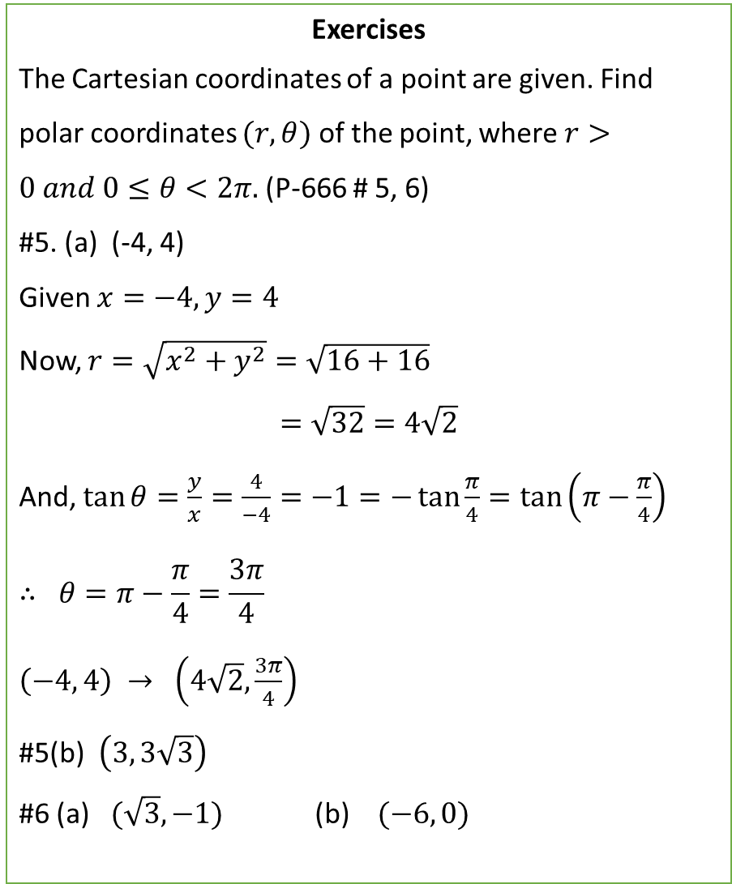
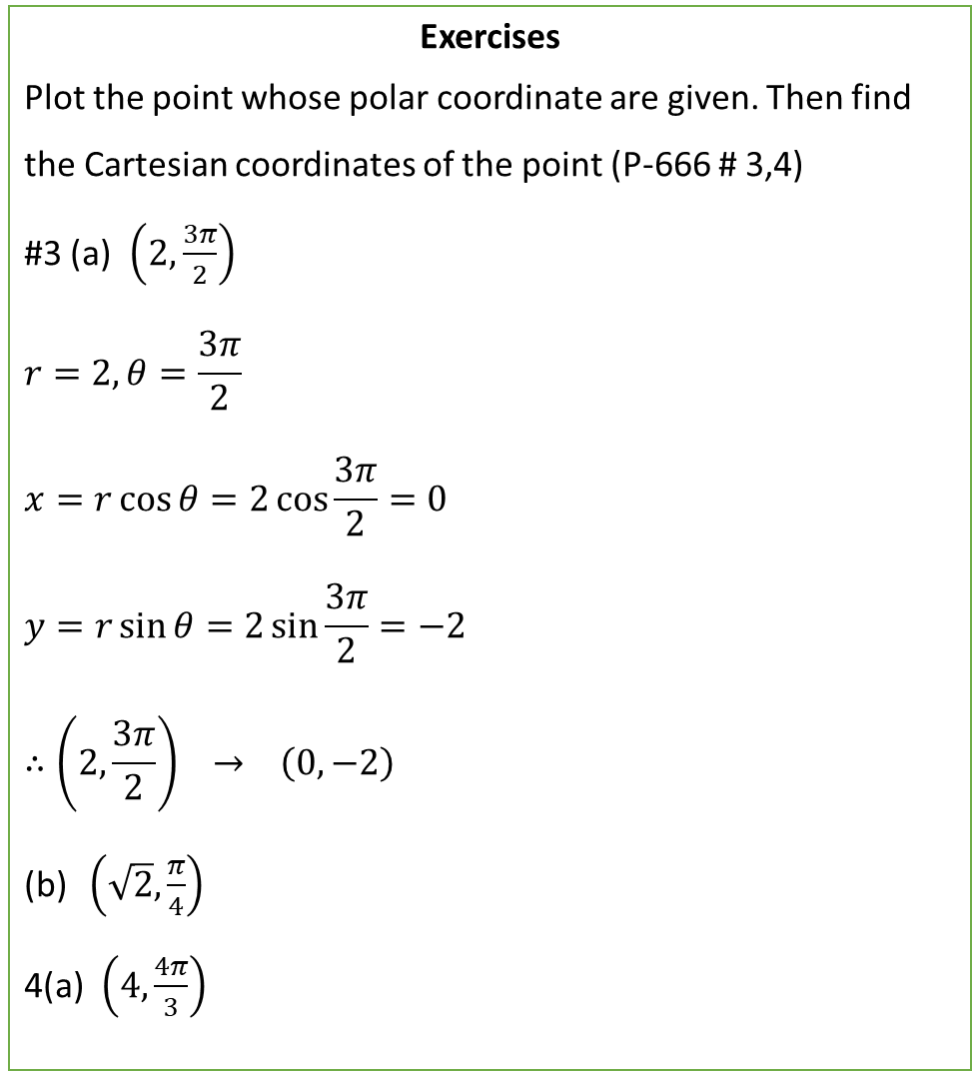
Exercises
Plot the point whose polar coordinate are given. Then find the Cartesian coordinates of the point (P-666 # 3,4)
#3 (a) $\left(2,\frac{3π}{2}\right)$
$$r=2, θ=\frac{3π}{2}$$
$$x=r\cos{θ=2\cos{\frac{3π}{2}=0}}$$
$$y=r\sin{θ}=2\sin{\frac{3π}{2}}=−2$$
$$∴\left(2,\frac{3π}{2}\right) → \left(0, −2\right)$$
$\left(\sqrt{2},\frac{π}{4}\right)$
4(a) $\left(4,\frac{4π}{3}\right)$
Exercises
The Cartesian coordinates of a point are given. Find polar coordinates $(r, θ)$ of the point, where $r>0 and 0≤θ<2π.$(P-666 # 5, 6)
#5. (a) (-4, 4)
Given $x=−4, y=4$
Now, $r=\sqrt{x^{2}+y^{2}}=\sqrt{16+16}$
$$=\sqrt{32}=4\sqrt{2}$$
And, $\tan{θ}=\frac{y}{x}=\frac{4}{−4}=−1=−\tan{\frac{π}{4}}=\tan\left(π−\frac{π}{4}\right)$
$$∴ θ=π−\frac{π}{4}=\frac{3π}{4}$$
$\left(−4, 4\right) → \left(4\sqrt{2},\frac{3π}{4}\right)$
#5(b) $\left(3, 3\sqrt{3}\right)$
#6 (a) $(\sqrt{3},−1)$ (b) $(−6, 0)$

Slide 15
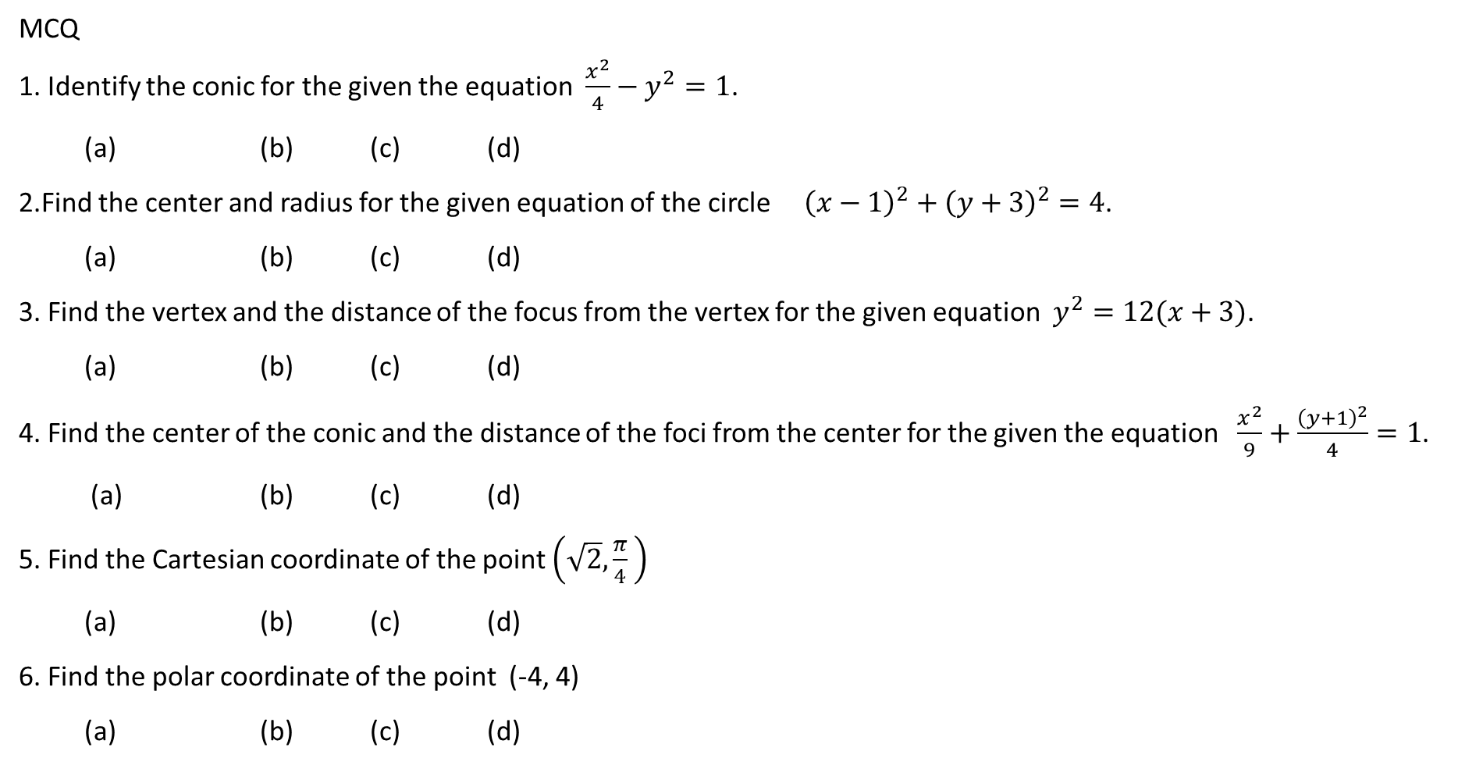
MCQ
1. Identify the conic for the given the equation $\frac{x^{2}}{4}−y^{2}=1$.
(a) (b) (c) (d)
2.Find the center and radius for the given equation of the circle ${\left(x−1\right)}^{2}+{\left(y+3\right)}^{2}=4$.
(a) (b) (c) (d)
3. Find the vertex and the distance of the focus from the vertex for the given equation $y^{2}=12(x+3)$.
(a) (b) (c) (d)
4. Find the center of the conic and the distance of the foci from the center for the given the equation $\frac{x^{2}}{9}+\frac{{\left(y+1\right)}^{2}}{4}=1$.
(a) (b) (c) (d)
5. Find the Cartesian coordinate of the point $\left(\sqrt{2},\frac{π}{4} \right)$
(a) (b) (c) (d)
6. Find the polar coordinate of the point (-4, 4)
(a) (b) (c) (d)

Slide 16
$$4x^{2}+8xy−4y^{2}−3x=5$$
Find an equation of a circle that satisfies the given condition
Center (-1, 5) passes through (-4, -6)

